Slide 1
Wireless Innovations Improving Productivity
2
CORRECT ISSUES
Immediate Communications
DISPLAY ISSUES
Visual Display Software
VT3000
Innovative
Wireless System
For the Production Floor
WWi
1
ANALYZE ISSUES
Graphs and Reports
PREVENT ISSUES
Corrective Action
Improved Productivity
Additional Production Output

Slide 2
Immediate Communications
Visual Management
Automatic Data Collection
Visual & Audio Andons
Real Time Performance Visibility
Factory Floor Communication • Andons • Real Time Performance Screens • Visual Factory • Automated Data Capture • OEE

Slide 3
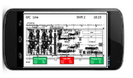
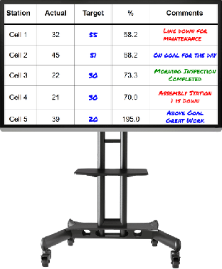
Eliminate Production Looses
Recover Lost Production Time
Minimizing Production Disruptions – Reduce Downtime
Identifying & Immediately Correcting Production Abnormalities
Immediate Communications of Production Issues
Visual Management
Performance Feedback to Line Operators
View Equipment or Production Station Status
View Line Status & Plant Status
Enterprise Status
Easily Identify Process Bottlenecks/ Areas for Improvement / Track Week to Week Improvements
Automatically Capture Performance Data
Significantly Improving the Accuracy /Timeliness/Consistency/Completeness of the Data
Factory Floor Communication • Andons • Real Time Performance Screens • Visual Factory • Automated Data Capture • OEE

Slide 4
VersaCall’s Customer’s include …
Factory Floor Communication • Andons • Real Time Performance Screens • Visual Factory • Automated Data Capture • OEE

Slide 5
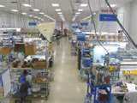
Supports All Manufacturing Environments
Machine Centers
Moving Assembly Lines & Stationary Assembly Operations
Packaging Line
Cell Manufacturing
Process Flow Lines
Production Lines
Factory Floor Communication • Andons • Real Time Performance Screens • Visual Factory • Automated Data Capture • OEE

Slide 6
VersaCall Success Stories
Turning Lost Downtime Into Productive Time
Qualifying Root Cause of Issues for Process Improvement
Visual Management - One Screen Complete Line Visibility
Efficient and Timely OEE Reports Improves Output
8 Hours of Downtime Turned Into Productive Time – 1st Month
250 Calls 1st Week - 70% Related to Material Issues
Individual Assembly Line Status
Line Output
Takt Time Performance Actual vs. Target
Lost Production Time
Individual Work Zone Status
Eliminated All Manual Data Collection – Immediate OEE Reports
Factory Floor Communication • Andons • Real Time Performance Screens • Visual Factory • Automated Data Capture • OEE

Slide 7
Financial Return – Payback 2 to 6 Months
Financial Paybacks Are Realized From:
Reducing Downtime – Immediate Communications of Issues
Reducing Set-Up Time
Automated Data Collection
Real Time Monitoring of Production Status – Identifying Abnormalities
Complete System Start at $7,500
Customer Example –System & Payback
VT3000 System - $10,100
Control Unit [Server] with Receiver
10 Input Modules – Call Stations
1 Repeater
Large Screen Display Software
2 Way Radio Transceiver
Financial Payback – 3.2 Months (Annual Return $37,500)
30 Incidents [10 Per Shift] – Total Plant – All Shifts - 4 Minute Savings Per Incident
3 Employees Affected Per Incident
Templates at Available For Calculating ROI
Factory Floor Communication • Andons • Real Time Performance Screens • Visual Factory • Automated Data Capture • OEE

Slide 8
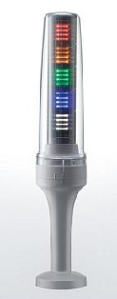
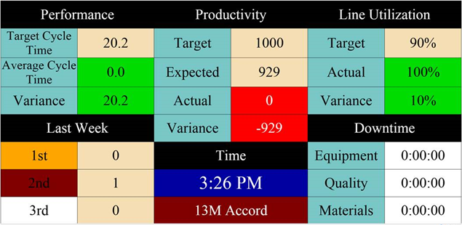
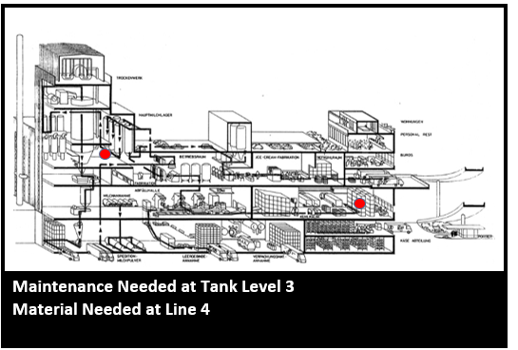
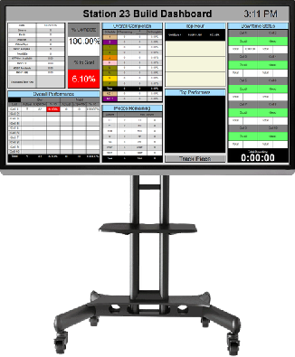
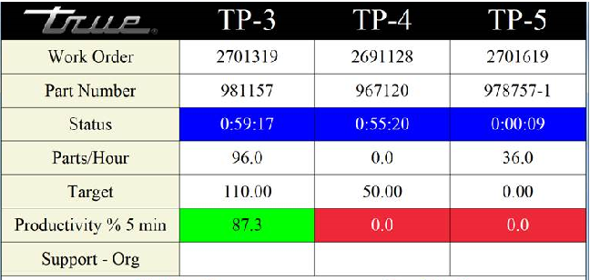
Innovations in Visual Management
New Andon Technology Un- Paralleled Performance Visibility
LED Light is completely Programmable
1
Factory Floor Communication • Andons • Real Time Performance Screens • Visual Factory • Automated Data Capture • OEE

Slide 9
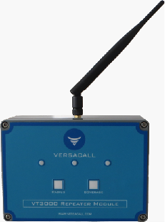
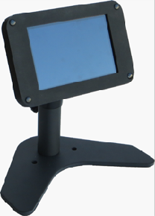
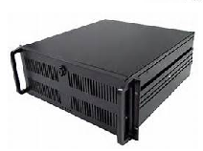
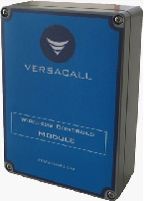
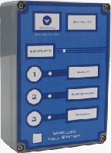
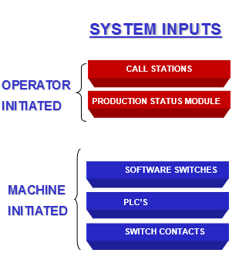
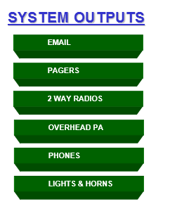
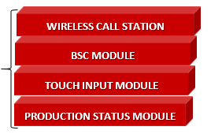
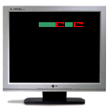
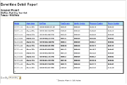
System Overview
1
System
Repeater
Wireless
Powered
System
Receiver
Input
Modules
VT 3000 Std Control Unit / Server
TOUCH INPUT MODULE
REAL-TIME SCREENS
SMART PHONES, TABLETS
& REPORTS
Factory Floor Communication • Andons • Real Time Performance Screens • Visual Factory • Automated Data Capture • OEE

Slide 10
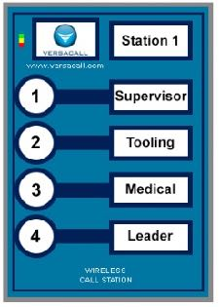
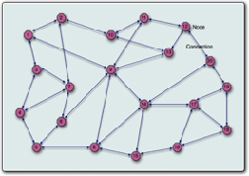
Call Station Input Module
Call Station - Battery or Powered
Captures Response Time to Issues
Introduces a Whole New Concept of Support Accountability
Also Escalates and Routes Messages Until Acknowledgement
Every Request for Support is Logged in Database [Time and Date Stamped ]
Provides Visibility of Support Personnel Response Performance to the Production Floor
Innovative Zigbee Wireless “Mesh” Technology
NEMA 4-sealed housing / Membrane Switch Buttons
Contains 4 Switch Contacts
Up to 1,500 Units per System – 6000 Monitoring Points in Control Unit [Server]
Communication Path for Each Individual Button is Programmable
DigiMesh Technology Forms
It's Own Network
Factory Floor Communication • Andons • Real Time Performance Screens • Visual Factory • Automated Data Capture • OEE

Slide 11
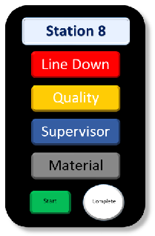
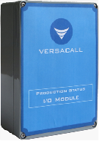
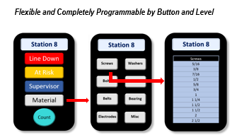
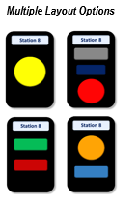
BSC Input Module - Flexible and Simple
BSC Module – Programmable Buttons
Choose Button Type, Color, Size & Quantity
Flexible Layouts
Programmable
Link Multiple Screens
Immediate Communications
Simple & Flexible
I/O Module
Touch Screen
Factory Floor Communication • Andons • Real Time Performance Screens • Visual Factory • Automated Data Capture • OEE

Slide 12
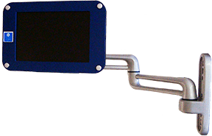
Touch Input Module - Visual Status Indicators
Touch Input Module – 7” Screens
Programmable & Configurable Touch Screen Displays
Number of Individuals to Call – Programmable 20+
Immediate Communications -Response Time & Escalations
Captures Counts & Downtime With Reasons
Full Touch Screen Keyboard & Key Pad
Factory Floor Communication • Andons • Real Time Performance Screens • Visual Factory • Automated Data Capture • OEE

Slide 13
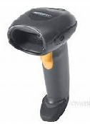
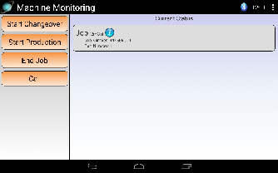
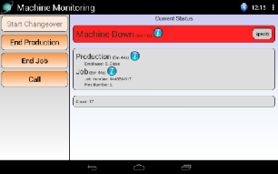
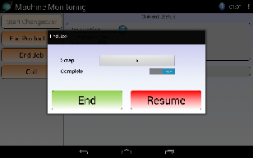
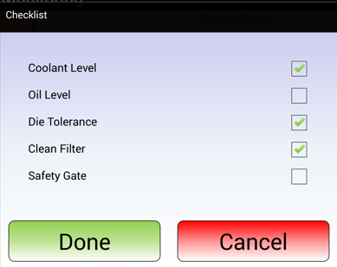
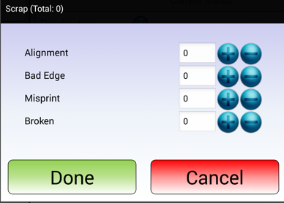
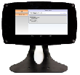
Production Status Module – Touch Screen [10” Screen] & I/O Module
Module Features
Configurable Touch Screen Display
Captures the Responding Individual w/ NFC Technology
Module Retrieves Data for Look Up List
Wireless Configuration Set-Up & Changes
Supports Wireless Bar Code Scanners
Clear Alarms/Actions from Different Modules
Full Communication Capabilities
Full Touch Screen Keyboard & Key Pad
Completely Configurable Screens
VESA Mounting Patterns Supports
Multiple Stand Options
Equipment
Mounts
Articulating Arms
Bench Stands
Floor Stands
Factory Floor Communication • Andons • Real Time Performance Screens • Visual Factory • Automated Data Capture • OEE

Slide 14
Touch Input Modules
Touch Screen Applications
Verification of Certified Operator or Trained Operator
Verifies that the operator has been trained on the equipment . Can Set-Up so Operator Must Perform Function Before Starting Equipment. Can have immediate communications to floor supervisor when there is an issue.
Check List
Can Set-Up so Operator Must Perform Function Before Starting Equipment.
Can be a Dynamic List –Change by Location or Station or Part Number
Request Material Including Quantities
Operator Pushes “Material Button” – List appears & operator select the material required. Material List is can be a
“Dynamic List” - it can be different by locations or Part Number being produced. Options to request the quantities required.
Run Jobs or Production Runs In Sequence
Production runs or job numbers that are to be run are loaded into the system by line management. Job sequence is shown on the touch screen.
Touch Screen Programmable Indicator Status
8 Programmable Indicator Status On the Screen - Each Screen Can Have It’s Own Indicators – Colors Change to Reflect Status
Factory Floor Communication • Andons • Real Time Performance Screens • Visual Factory • Automated Data Capture • OEE

Slide 15
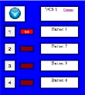
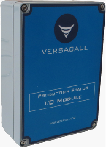
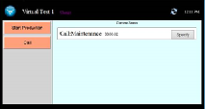
Additional Modules
Wireless Switch Contact Module – Input Module
Unit
Wireless Controls Module
1Computer Screen Modules
PC Modules
For LAN Connected PC’s
Touch Screen or Mouse
PC Call Station
Add’l Buttons Can Be Added
PC Input Module
Flexible –Layout Completely Configurable
1Wireless
Simple Inputs
Normally Open/Closed
Fully Programmable
1Wireless Activation
Lights
Horns
Speakers
Inputs Can Control Outputs
Program remotely
Moving Assembly Module
I / O Module
1Wireless
Full Communications
Simple to Use – One Button to Signify Work Complete
Captures Assembly Performance within Assembly Line
Automatically Resets
Repeater
1Wireless
Machine Interface
4 Inputs
7 Outputs
Inputs Can Control Outputs
Factory Floor Communication • Andons • Real Time Performance Screens • Visual Factory • Automated Data Capture • OEE

Slide 16
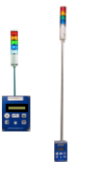
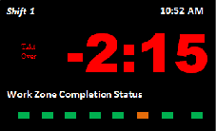
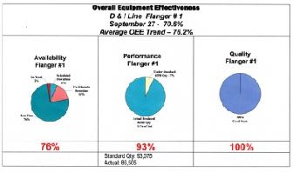
Primary Applications
1
Andons & Communications
Audio & Visual Andons
Immediate Communications of Issues
Wired & Wirelessly Activated Modules
Machine Monitoring Applications
Captures Lot Number or Production Run Performance Information
Captures Scrap by Reason Code / Downtime by Reason Code
Moving Assembly Line
Simple – Operator Input
Measures Each Segments Performance
Identifies Pacing Segment
Stationary Assembly Operations
Measures Assembly Activity Against Standards
Visibility Status of Assembly Activity
Immediate Communications of Issues
OEE
Complete System – Data Capture to Reporting
Eliminates Manual Data Collection
Critical Visibility for Addressing Issues
Factory Floor Communication • Andons • Real Time Performance Screens • Visual Factory • Automated Data Capture • OEE

Slide 17
Innovative Software that Expands The System Capabilities
Software Tools That Allows Customers to Easily Modify & Reconfigure Their System’s Operation
VT3000 Advanced Monitoring Software – AMS
What It Provides
The AM Software provides the capability to monitor for a status or a condition. When this status or condition occurs specific pre-defined actions are initiated.
AMS - Powerful Tool for Easily Developing Custom System Solution
VT3000 Advanced Scheduling Software
What It Provides
The AS Software provide the capability to schedule predefined specific actions. These actions can be for set times or linked to shifts.
Factory Floor Communication • Andons • Real Time Performance Screens • Visual Factory • Automated Data Capture • OEE

Slide 18
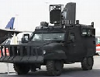
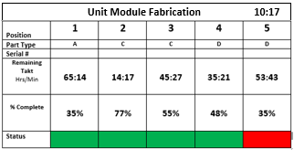
Innovative Approach for Capturing Operational Performance – Accomplishment
Measure Performance Status by Measuring Accomplishment
Applies to Manufacturing That Does Not Have Standard Performance Measurement
One of a Kind Production – Custom – Large Unit Assembly
Allows You to Measure What You Have Not Been Able to Measure in the Past
Immediate Visibility of Unit Completion Status
Customizable & Adaptable to Any Type of Unit or Version of the Unit
Simple – Measure Accomplishment or Task Completion
Line Personnel Simply Checks a Box When Individual Task
is Completed or Accomplished
Flexible – Can Be Utilized for End Units or Sub-Assemblies Units
Instant Communication of Issues
Factory Floor Communication • Andons • Real Time Performance Screens • Visual Factory • Automated Data Capture • OEE

Slide 19
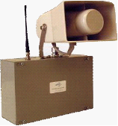
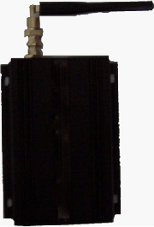
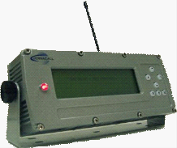
Multiple Outputs Options
1
1
E-Mail
Andon Lights
Sizes Up to 100MM
Poles up to 10’ +
Audio Andons - Wireless Horns
MP3 Player - Up to 105 dB
Any Sound / Tune / Music
2 Way Radios & Transceiver
Supports Up to 8 Channels
Vehicle Mounted Display
Forklifts, Tuggers, Lift Trucks
Wireless
On- Site Paging Transmitter
On-Site Pagers
2 Lines - Easy to Read
1
Desktop & Cell Phones
Factory Floor Communication • Andons • Real Time Performance Screens • Visual Factory • Automated Data Capture • OEE

Slide 20
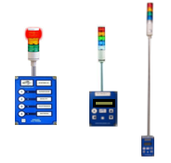
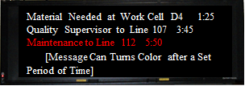
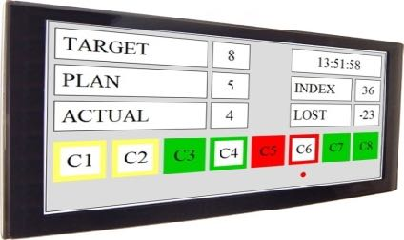
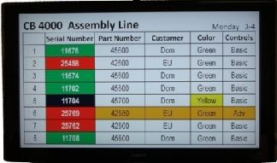
Completely Integrated Visual Andon Systems A New Dimension in Visual Communications for the Production Floor - Virtual Panel IV Display Software
Communications Support Request
Fully Integrated Andon Systems
From Input Modules to Displays
Input Modules
Production Activity Status
Virtual Panel IV Software
New Panel Software
Systematic Panel Generation Process
Wizard Guides Panel Development
Significant Reduction in Panel Creation Time
Improved Options in Panel Development Choices
Easy Correction Feature
Production Schedule
VP IV Software Right Sizes to Device – Same Screen on a Smart Phone as Large Screen Display
Factory Floor Communication • Andons • Real Time Performance Screens • Visual Factory • Automated Data Capture • OEE

Slide 21
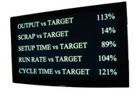
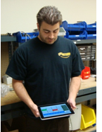
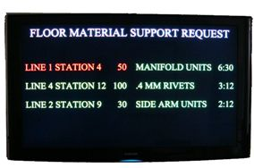
Linking Communications With Visual & Audio Andon Notification
Un-Paralleled Performance Visibility
Line Performance – Stack Lights
Operator / Cell / Equipment Performance
Android & iPad Tablets
Production Floor - White Boards
Material Support
Smart Phone KPI’s
Factory Floor Communication • Andons • Real Time Performance Screens • Visual Factory • Automated Data Capture • OEE

Slide 22
Visual Management
Updating Graphs & Real Time Performance Information
Unique Visual Management Solutions
Factory Floor Communication • Andons • Real Time Performance Screens • Visual Factory • Automated Data Capture • OEE

Slide 23
Virtual Panel IV Software Andon – Messaging- Performance – Plant Layout – Informational
VP IV Software
Multiple Layout Options / Flexibility
• Type of Information Displayed
Plant Wide Information Messages
Factory Floor/ Line Performance Status
Real Time Performance Status
• What is Displayed
Text, Images, Scrolling Messages, Counts, Duration
Calculations, Conditional Messages, States, Formulas
• How Information is Displayed
Choose Font Size, Font Types, Font Color, Flashing
Panel or Flashing Letters, Real Time Update Rates
• Where / Sequence of Information
Target Specific Areas
Entire Plant
• User Friendly Tools –On Line
Interactive On-Line Session
Design Your Own Screen Layouts
• Start With Example Templates
Andons / Messaging / Informational / Performance / Combo
• Using Step by Step Wizards
Develop Screen Layouts
Process Takes 20 Minutes
Final Layout that Fits Your Needs
• Alternative - Developing Custom Screens Layout Solutions
Andons
Messaging
Informational
Performance
Combo
Plant Layouts
Factory Floor Communication • Andons • Real Time Performance Screens • Visual Factory • Automated Data Capture • OEE

Slide 24
VersaCall Reporting Software II Software That Produces Trend and Comparison Graphs & Reports That Are Easy to Create and Change
Template Approach Provides Rapid Report Generation
Other Features
• Automatic Report Generation Feature
Reports Automatically Created for Shift , Day , Week - Sent Directly to Your E-mail
• Clear /Concise Graphs & Report Formats
Immediately Spot Issues & Root Causes – Simple Red/ Yellow / Green Designations
• Financial Performance Impacts Feature
Reports that Profile the Cost of Downtime & the Cost of Scrap
• Configure Custom Reports & Graphs
Adding In Your Own Title & Logo
• Apply Standards & Target References
Pull Reference Standards for Existing Databases or Look Up Tables Using Data Look Up Manager
• Step by Report Generation Using Wizards & Choosing Templates
Factory Floor Communication • Andons • Real Time Performance Screens • Visual Factory • Automated Data Capture • OEE

Slide 25
Summary of Additional System Features and Capabilities
Verification of Certified or Trained Operators On Machines – immediate communication
to floor supervision when there is a issue.
Lock Out – Reason Code must be selected before the equipment can be re-started
Secondary Communications – After a defined period has lapsed, then a secondary communication path is initiated for an incident
Integration with Existing Software System – Non Invasive – Site is in complete control
Look Up Tables – Flexibility to set up varying shifts , Breaks , Lunch Period
Advance Monitoring Software – Predefine a set of parameter triggers & actions – system monitors for the parameters
Advanced Scheduling Software – Predefined trigger based upon a date, time or a count,
System monitors for the date, time or count
Preventative Maintenance Packaging is in Development
System Monitoring Software - Software That Insures Your VT3000 System is Operational
Factory Floor Communication • Andons • Real Time Performance Screens • Visual Factory • Automated Data Capture • OEE

Slide 26
Moving Forward - Identifying Your Application
Step 1 - Start Small - Identify One or Two Critical Problem Areas
Step 2 - Clearly Identify the Results You Want To Achieve - Define Your System Solution – Metric Visibility
Visual Performance Visibility
Trend & Analysis Reports and Graphs - Performance Information That Makes a Difference
Step 3 - Work with VersaCall to Develop an Application Profile
Lay Out a Solution for Addressing the Problem Areas - Including the Modules & Financial Justification
Also Installation & Configuration Packages Available
Messaging
Performance
Information
Andons
Design You Own Layout
Downtime
Communications
Performance
Trends
Download to Excel
For Developing a System Solution – We want to start where you want to end.
Factory Floor Communication • Andons • Real Time Performance Screens • Visual Factory • Automated Data Capture • OEE

